Slide 1
Used Car Price Analysis
Data Scraping, Cleaning, and Visualization using Python & Power BI
Presented By:
Charitha Akula

Slide 2
Introduction
Purpose of project: analyzing used car prices in Hyderabad
Objective & Goals:
  Scrape real-world data
  Clean & preprocess data
  Visualize insights using Python & Power BI
  Provide recommendations
Tools & Technologies:
Python: for web scraping, data cleaning, data manipulation.
Libraries: Pandas, Requests, BeautifulSoup, ThreadPoolExecutor, Matplotlib.
Power BI: for dashboards, drill-through, and interactive analysis.

Slide 3

Data collection (Python Web Scrapping)
Source: Car Dekho – Used Cars in Hyderabad
Method: requests + BeautifulSoup
Multi-page scraping with loop (page 1–3)
Extracted features: Title, Price, KM Driven, Fuel, Transmission, Owner, EMI

Slide 4
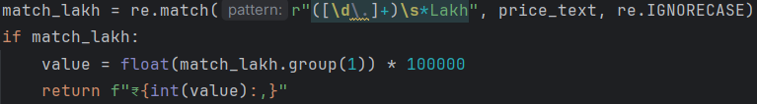
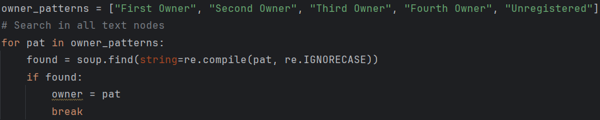
Data Cleaning:
Converted Price from Lakh/Crore → Numeric ₹ value
Removed commas in KM Driven → Numeric field
Standardized categorical fields (Fuel, Transmission, Owner)

Slide 5
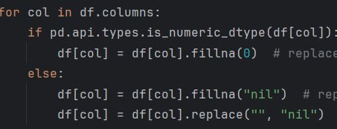
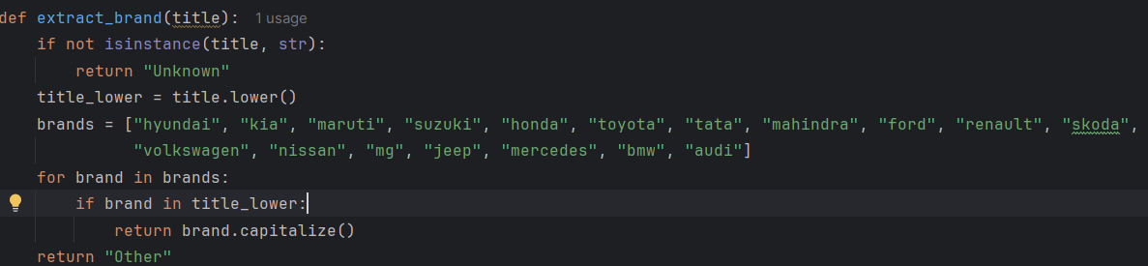
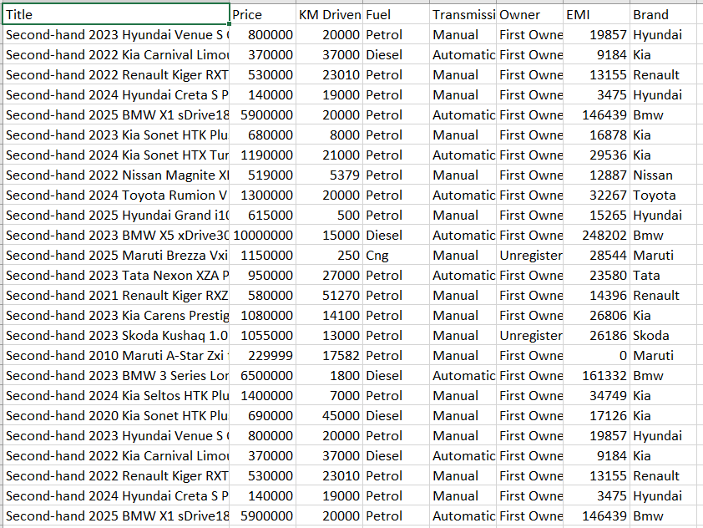
Handled missing values → replaced with “nil” / 0
Extracted Brand Name from Title

Slide 6
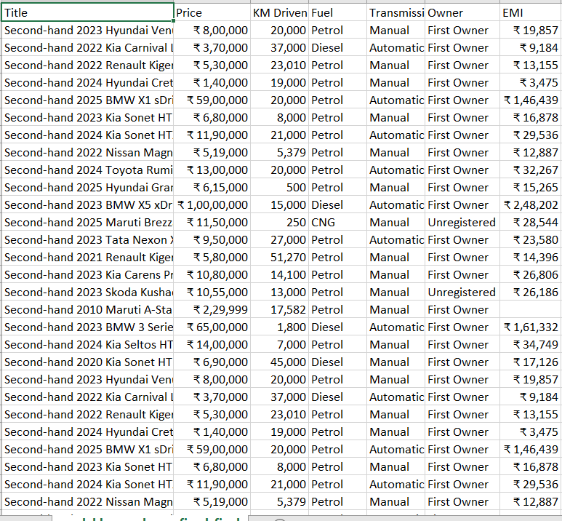
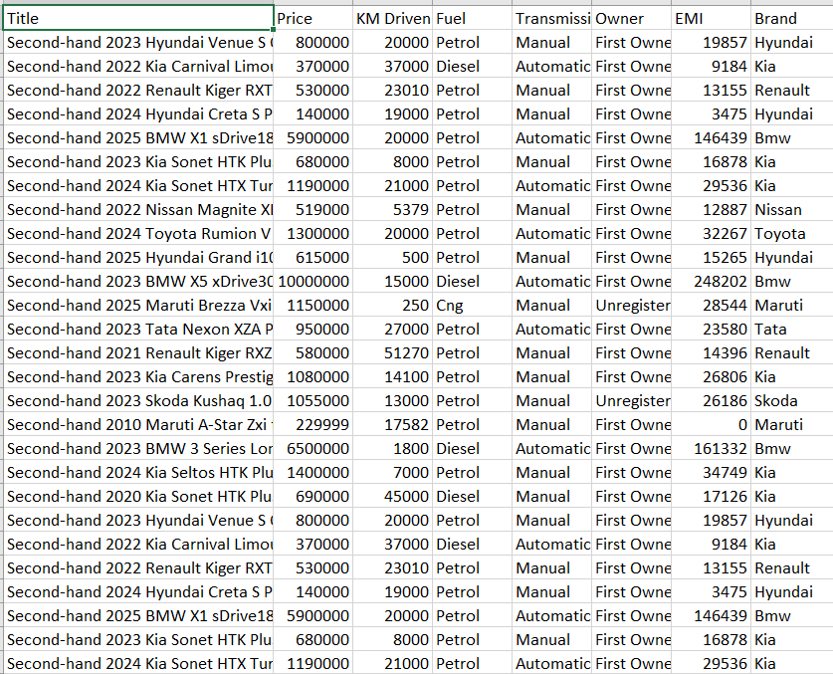
Data Storage:
Raw data saved as cardekho_used_cars_fixed_final.csv
Cleaned data saved as cardekho_used_cars_cleaned_with_brand.csv

Slide 7
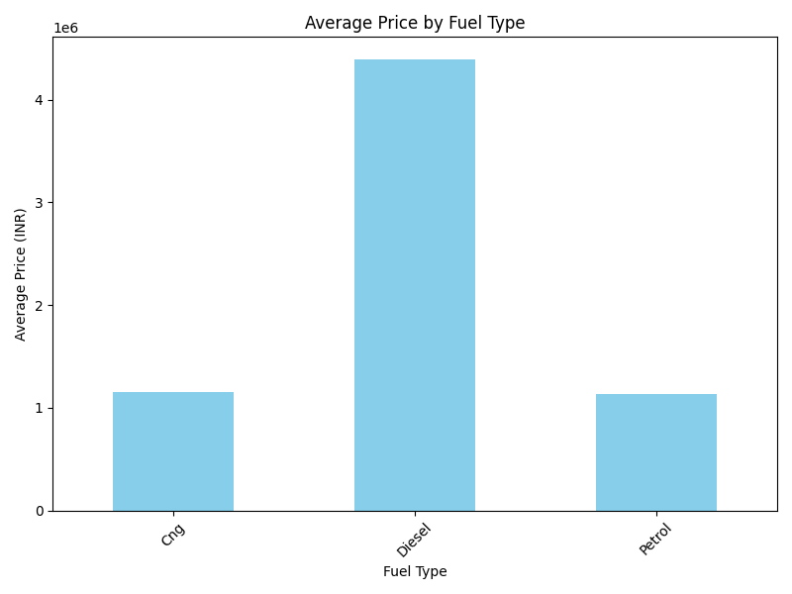
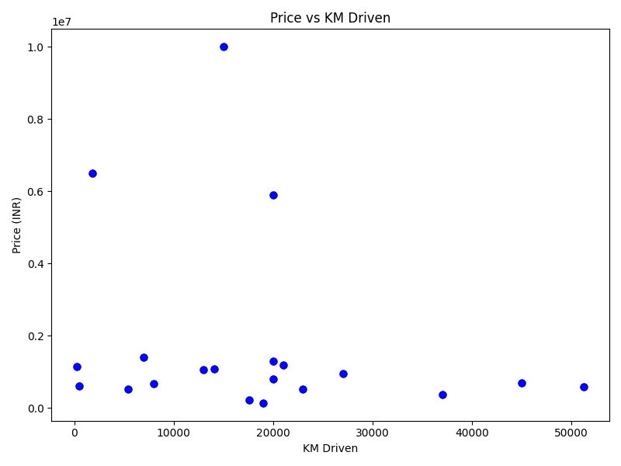
Exploratory Data Analysis (Python):
Average price by fuel type
Price vs KM Driven

Slide 8
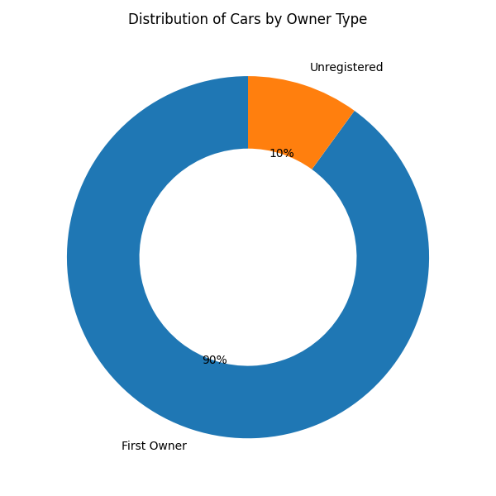
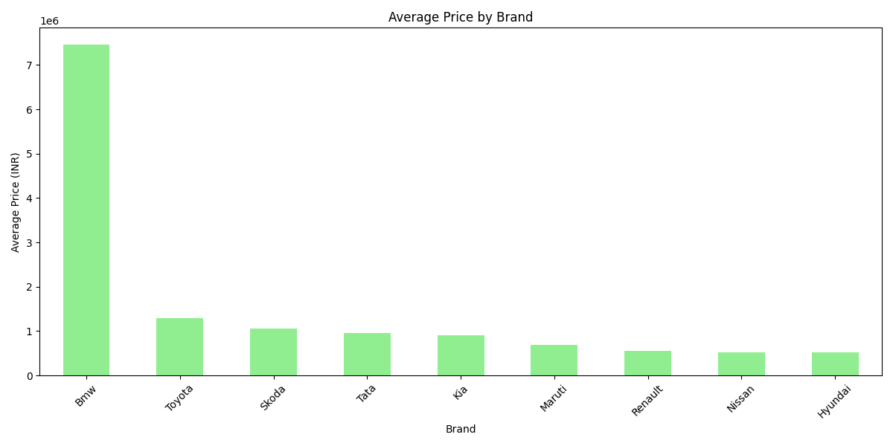
Avg Price by Brand
Count of Title by Owner

Slide 9
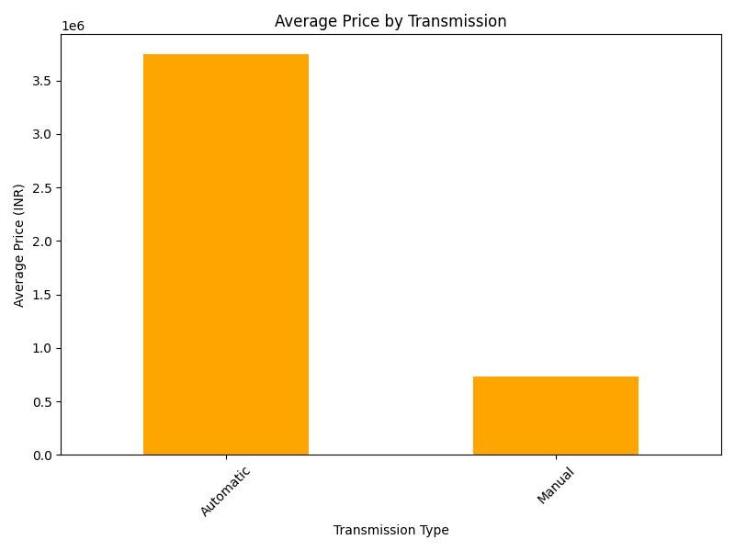
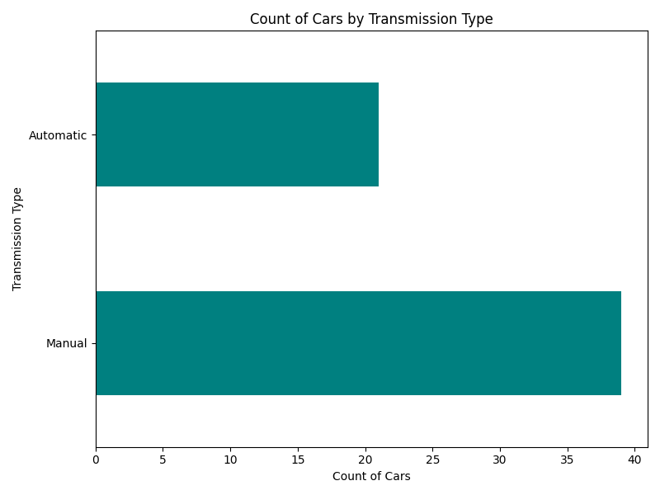
Avg Price vs Transmission
Count of Title by Transmission

Slide 10
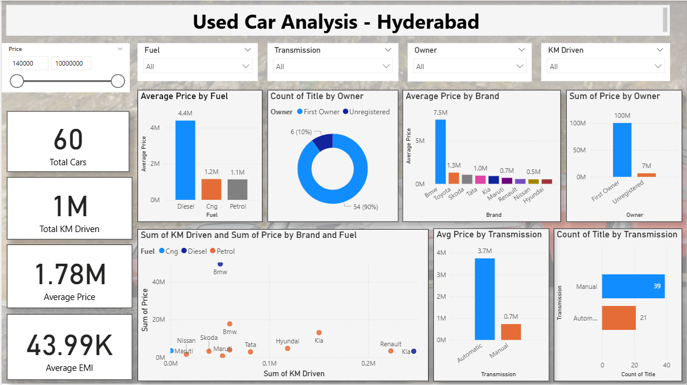
Power BI Dashboard (Main View):
KPIs: Average Price, Total Cars, Distribution by Fuel/Brand
Visuals: Donut, Bar, Clustered Column
Applied slicers: Fuel, Transmission, Brand
Unified color scheme

Slide 11
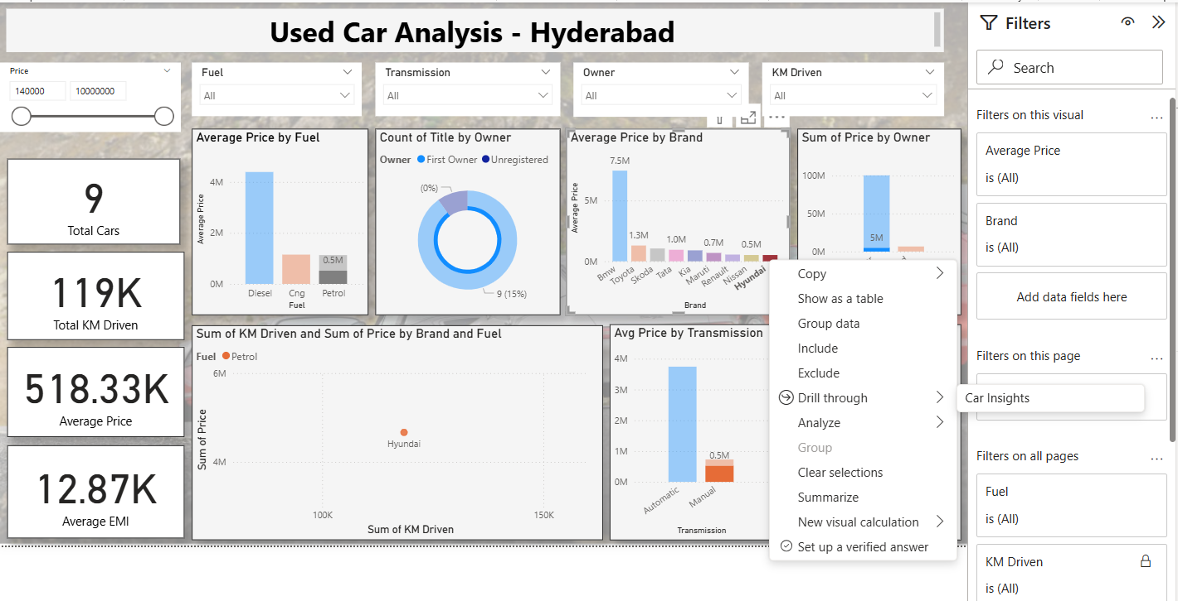
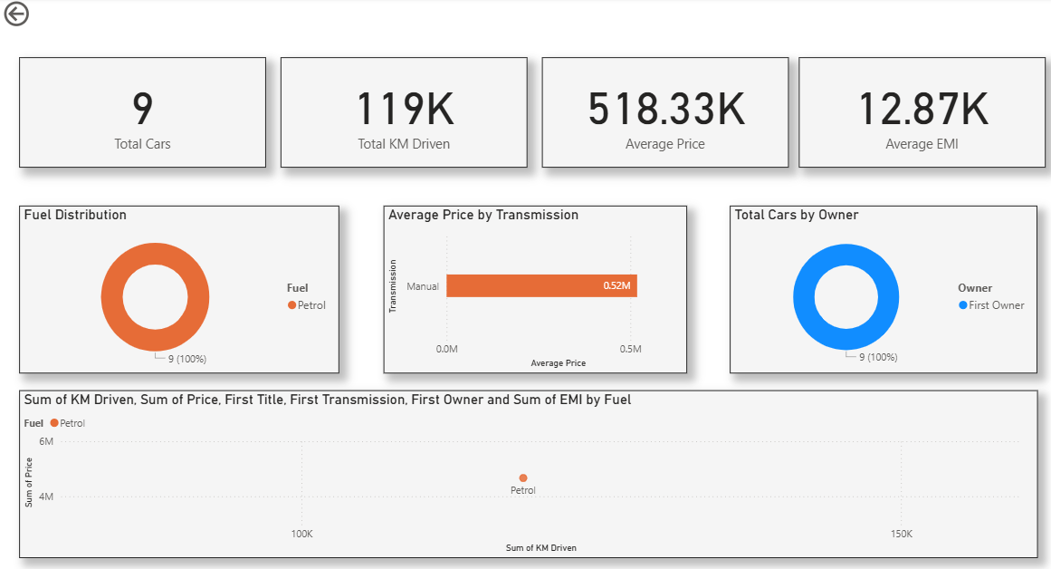
Drill-Through in Power BI:
Created Car Insights Page
Users can right-click on Brand/Fuel → See details
Drill-through filter applied
Example: Hyundai drill-through → shows average price, KM driven, EMI

Slide 12
Insights and Findings:
Diesel cars have higher average prices.
Manual cars dominate the market, but Automatics are costlier.
BMW cars have the highest average resale value.
First Owner cars form the majority, improving buyer trust.
Business Implications:
Buyers: Can filter affordable cars quickly
Dealers: Can track which brands/models sell fastest
Finance: EMI insights help promote car loans

Slide 13
Challenges happened:
Website structure inconsistencies (Owner info not always available)
Cleaning Lakh/Crore → standard numeric format
Handling missing / inconsistent categorical values
Integrating multiple tools (Python → CSV → Power BI)
Future Enhancements:
Expand scraping beyond Hyderabad (multi-city analysis)
Add ML model for price prediction
Real-time dashboards with auto-refresh
Compare multiple car-selling websites

Slide 14
Conclusion:
Python automated scraping & cleaning
Power BI provided interactive dashboards

